Slide 1
Pneumonia Detection Using Deep Learning
Digital Health-care Application
Shubham Pokhriyal
Sec: A 53
Roll no: 2018763

Slide 2
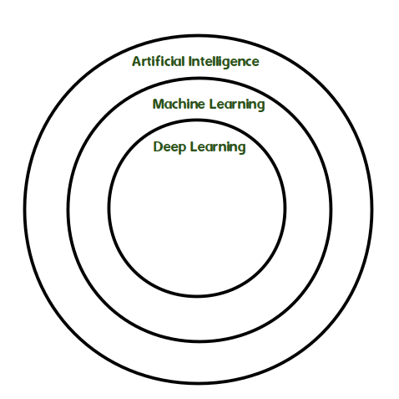
Deep Learning
Deep learning is a branch of machine learning completely based on artificial neural networks, as the neural network will mimic the human brain, so deep learning is also a kind of mimic of the human brain.
In the human brain approximately 100 billion neurons altogether this is a picture of an individual neuron and each neuron is connected through thousand of its neighbors.
The question here is how we recreate these neurons in a computer. So, we create an artificial structure called an artificial neural net where we have nodes or neurons

Slide 3
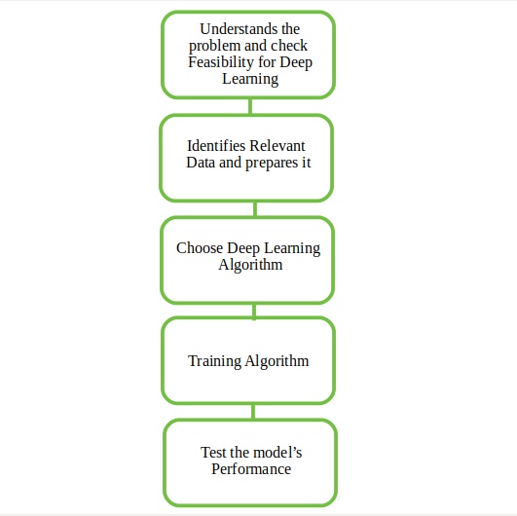
Workflow of the model :
Pneumonia Detection is a classical image classification model.
I have used a Pneumonia survey dataset.
Used CNN for image classification.
By splitting the data set I’ve trained and tested the model.
Used Open CV library for Image Processing.
Used Tkinter library for Graphical User Interface.
Used TensorFlow to create the neural network and plot the graph.

Slide 4
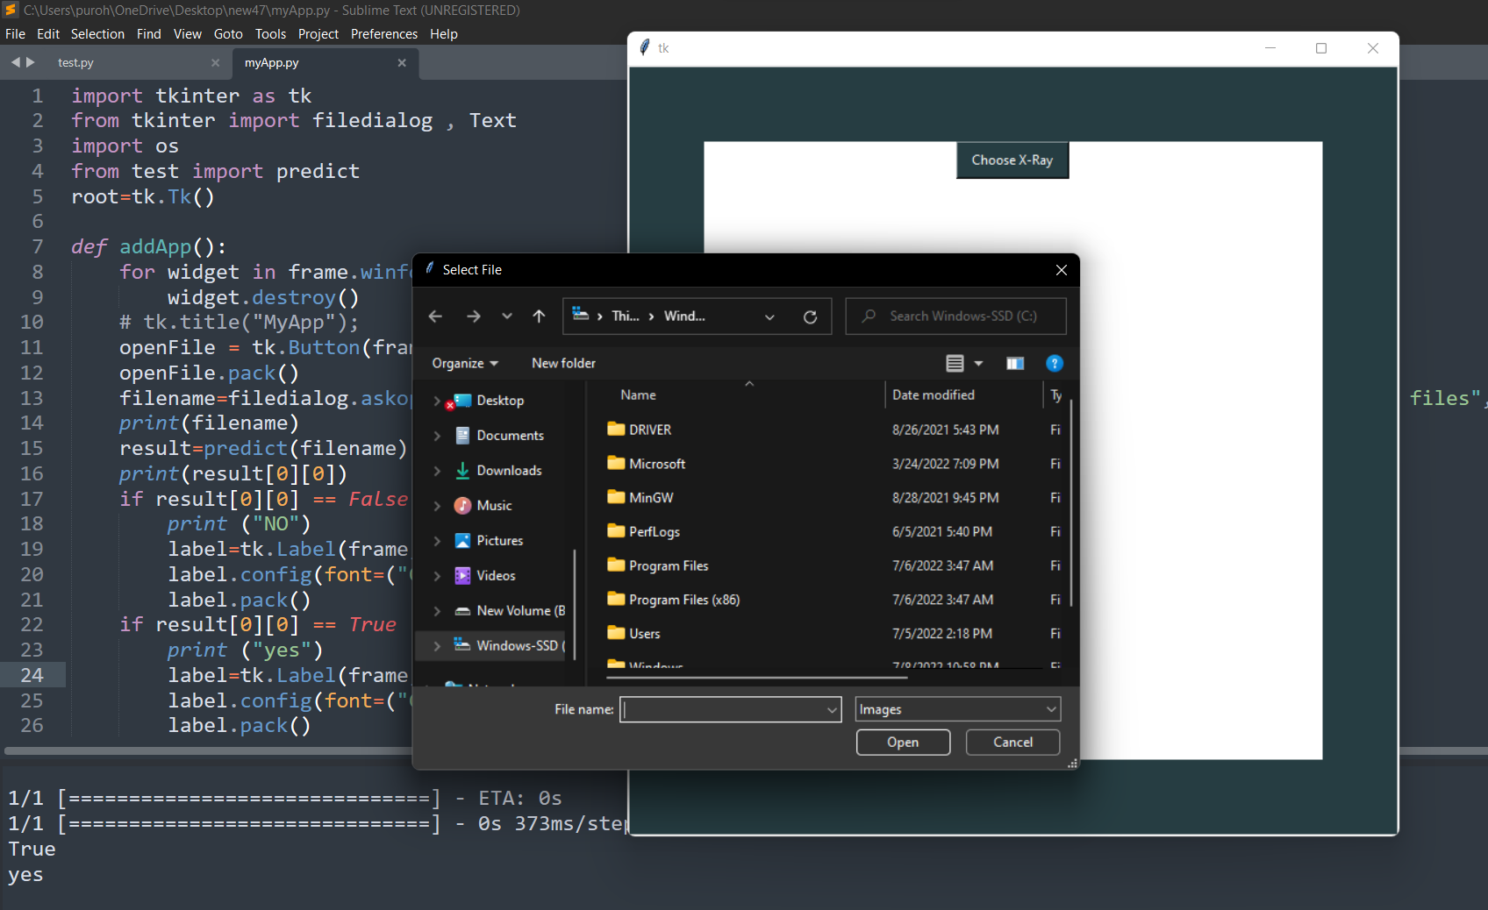

Slide 5
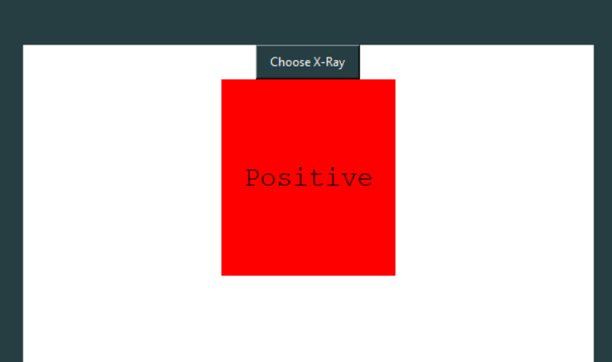
Results:

Slide 6
Thank You

